Slide 1
Systems Analysis and Design 9th Edition
Khayyam H. MASIYEV
BHOS☺
Information Security Division
Senior Lecturer
khayyam.masiyev@bhos.edu.az
Chapter 3
Managing Systems Projects
Part 2

Slide 2
Course Content
Project Management: This course provides an overview of the project environment, life-cycle and organization. It provides detailed coverage of the ten knowledge areas defined in "A Guide to the Project Management Body of Knowledge, (PMBOK® Guide) - Project Management Institute ":
Scope Management
Time Management
Cost Management
Quality Management
Human Resources Management
Communications Management
Risk Management
Procurement Management
Stakeholder Management
Integration Management
Managing Systems Projects – WBS, GanttChart, PDM, PERT, CPM

Slide 3
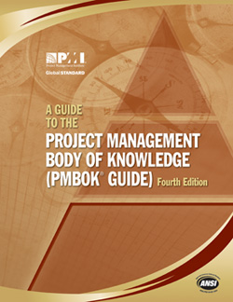
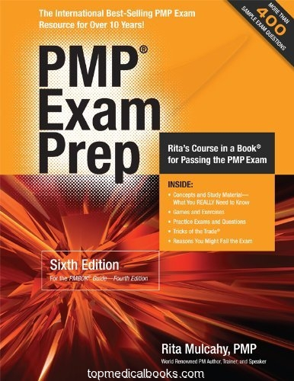
References for PMP Study
This course is using following resources as references:
A Guide to The Project Management Body of Knowledge (PMBOK Guide) © PMI
PMP Exam Prep, Rita’s Course in a Book for passing the PMP Exam © Rita Mulcahy, PMP
And others (some I will share with you)

Slide 4
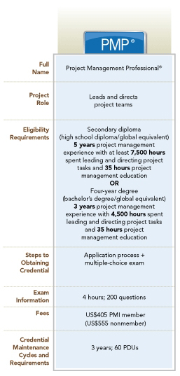

PMI & PMP
The Project Management Institute (PMI) is project management professional association with over 500,000 member. Established in 1969 and located in US.
Project Management Professional (PMP) credential recognizes demonstrated knowledge and skill in leading and directing project teams and in delivering project results within the constraints of schedule, budget and resources.
PMI, PMBOK, PMP are registered marks of Project Management Institute, Inc.

Slide 5
PMBOK Guide
Is a standard (formal document that describes established norms, methods, processes and practices)
Guidelines for managing individual projects
A good practices which are applicable to most project most of the time
A common vocabulary within project management profession
A foundational project management reference
PMI Code of Ethics and Professional Conduct is also requirement for PMP certification

Slide 6
Advantages of Using Formal Project Management
Better control of financial, physical, and human resources
Improved customer relations
Shorter development times
Lower costs
Higher quality and increased reliability
Higher profit margins
Improved productivity
Improved productivity
Better internal coordination
Higher worker morale (less stress)

Slide 7
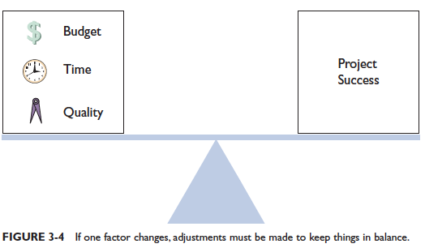
What is Project?
A Project is a temporary endeavor (try) undertaken to create a unique, product, service, or result.
Temporary = a definite beginning and end.
A successful project must be completed on time, within budget, and deliver a quality product that satisfies users and meets requirements.

Slide 8
Project Attributes
A project:
Has a unique purpose
Is temporary
Is developed using progressive elaboration
Requires resources, often from various areas
Should have a primary customer or sponsor
The project sponsor usually provides the direction and funding for the project

Slide 9
What is Project Management?
The application of knowledge, skills, tools and technique to project activities to meet project requirements
Project Management is accomplished through the application and integration of the processes which are grouped in the 5 process groups:
Initiating
Planning
Executing
Monitoring and Controlling
Closing
What Does a Project Manager Do?
Project manager, project leader
Project planning
Project scheduling
Project monitoring and controlling
Project reporting

Slide 10
Managing Project
The Project Manager is the person responsible for accomplishing the project objectives.
Managing a project includes:
Identifying requirements.
Establishing clear and achievable objectives.
Balancing the competing demands of quality, scope, time and cost.
Adapting the specifications, plans, and approach to the different concerns and expectations of the various stakeholders.

Slide 11
Project Constraints
Every project is constrained in different ways by its:
Scope
Schedule/Time
Cost/Budget
Quality
Resources
Risk
If any one factor changes, at least one other factor is likely to be affected.
It is the project manager’s duty to balance these competing constraints.
COST/RESOURCES
SCHEDULE/TIME
The Triple Constraint
or
The Trade-off Triangle
SCOPE/QUALITY

Slide 12
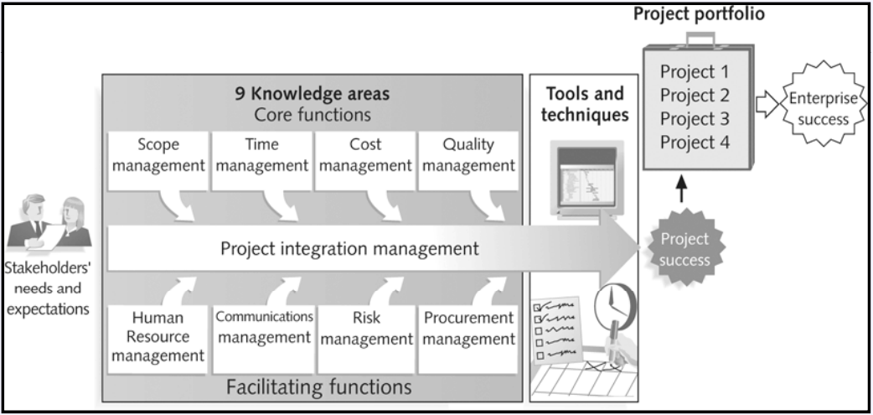
Project Management Framework

Slide 13
Project Management Knowledge Areas
Four core knowledge areas lead to specific project objectives.
Project scope management involves defining and managing all the work required to complete the project successfully.
Project time management includes estimating how long it will take to complete the work, developing an acceptable project schedule, and ensuring timely completion of the project.
Project cost management consists of preparing and managing the budget for the project.
Project quality management ensures that the project will satisfy the stated or implied needs for which it was undertaken.

Slide 14
Project Management Knowledge Areas
Four facilitating knowledge areas are the means through which the project objectives are achieved.
Project human resource management is concerned with making effective use of the people involved with the project.
Project communications management involves generating, collecting, disseminating, and storing project information.
Project risk management includes identifying, analyzing, and responding to risks related to the project.
Project procurement management involves acquiring or procuring goods and services for a project from outside the performing organization.
One knowledge area (project integration management) affects and is affected by all of the other knowledge areas.

Slide 15
Project Management Tools and Techniques
Project management tools and techniques assist project managers and their teams in various aspects of project management.
Note that a tool or technique is more than just a software package.
Specific tools and techniques include:
Project charters, scope statements, and WBS (scope)
Gantt charts, network diagrams, critical path analyses (time)
Net present value, cost estimates, and earned value management (cost)

Slide 16

Project Success
There are different ways to define project success:
The project met scope, time, and cost goals.
The project satisfied the customer/sponsor.
The project produced the desired results.

Slide 17
Relationships Among Project Management, Program Management and Portfolio Management
Project Management
Program Management
Portfolio Management
Project Management Office
Portfolio
Program
Projects & Operation
PMO

Slide 18
What is a Program?
A program is:
“a group of related projects managed in a coordinated way to obtain benefits and control not available from managing them individually.”
A program manager provides leadership and direction for the project managers heading the projects within the program.
ADVANTAGES
Decreased risk

Slide 19
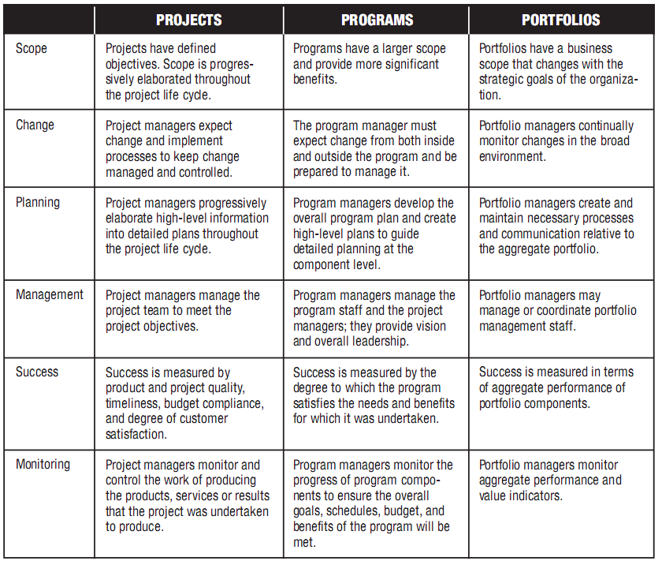
Comparative Overview

Slide 20
Stakeholders
Stakeholders are persons or organizations who are actively involved in the project or whose interests may positively or negatively affected by the performance or completion of the project.
Stakeholders have varying levels of responsibility and authority and can change over the project life cycle
Project management team must continuously identify both external and internal stakeholders
Project manager must manage the influence of various stakeholders in relation to the requirements and balance stakeholders’ interest

Slide 21
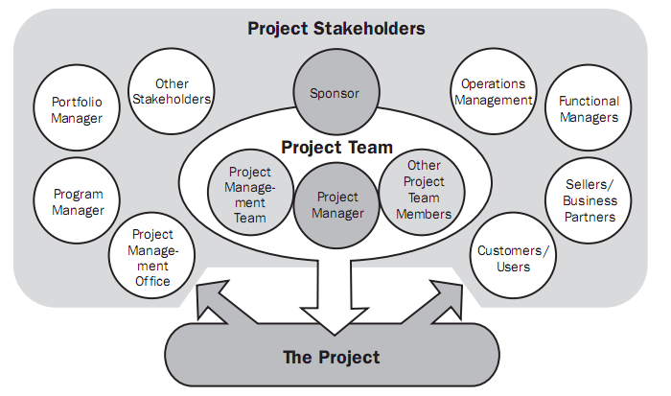
Stakeholders
Some examples of project stakeholders

Slide 22
Project Management Process
Monitoring &
Controlling Processes
Planning
Processes
Enter phase/
Start project
Initiating
Processes
Closing
Processes
Exit phase/
End project
Executing
Processes
Project
Boundaries

Slide 23
Process Groups & Knowledge Areas Mapping
Knowledge Area | Process
 | Initiating | Planning | Executing | Monitoring & Control | Closing
Integration | Develop Project Charter (regulation) | Develop Project Management Plan | Direct and Manage Project Execution | Monitor and Control Project Work Perform Integrated Change Control | Close Project
Scope |  | Collect Requirements Define Scope Create WBS |  | Verify Scope Control Scope
Time |  | Define Activities Sequence Activities Estimate Activities Resources Estimate Activities Duration Develop Schedule |  | Control Schedule
Cost |  | Estimate Costs Determine Budget |  | Control Costs
Quality |  | Plan Quality | Perform Quality Assurance | Perform Quality Control
Human Resource |  | Develop Human Resources Plan | Acquire Project Team Develop Project Team Manage Project Team
Communication | Identify Stakeholders | Plan Communications | Distribute Information Manage Stakeholders Expectations | Report Performance
Risk |  | Plan Risk Management Identify Risk Perform Qualitative Risk Analysis Perform Quantitative Risk Analysis Plan Risk Response |  | Monitor and Control Risks
Procurement |  | Plan Procurements | Conduct Procurements | Administer Procurements | Close Procurements

Slide 24
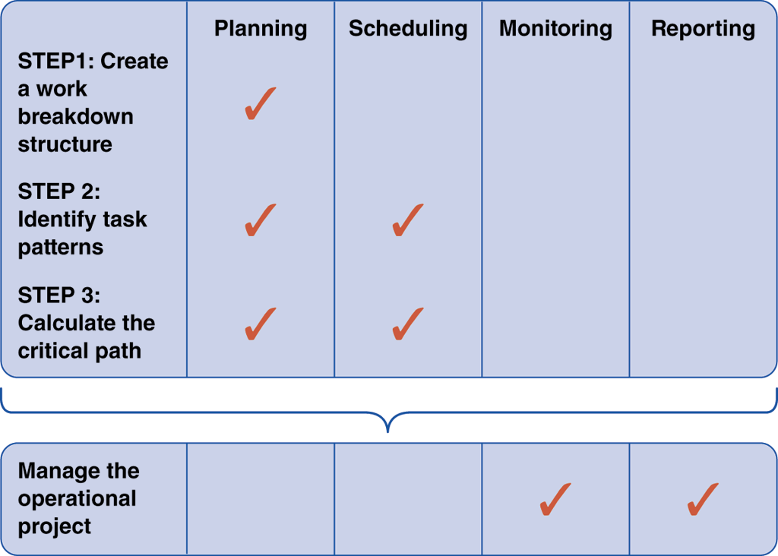
Overview of Project Management
Project Activities and Planning Steps

Slide 25
Project Activities and Planning Steps
Step 1. Create WBS (Work Breakdown Structure)
Step 2. Identify Task Patterns
Step 3. Calculate Critical Path
Step 4. Manage the Operational Path

Slide 26
Step 1: Create a Work Breakdown Structure
Work breakdown structure (WBS)
A work breakdown structure (WBS) involves breaking a project down into a series of smaller tasks ( components, subcomponents, activities and tasks) .
Scope – All the tasks that make up a project, no more, no less
The lowest level of the WBS – where the work is actually assigned – is called a work package

Slide 27
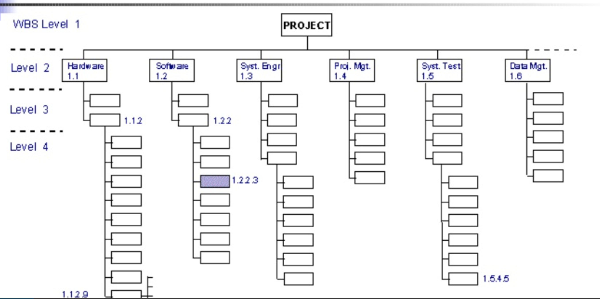
WBS

Slide 28
WBS - Levels
Level 1 – Overall Project Definition
Highest – level entry corresponds to the overall project delivearble. E.g., Software Development Project
Level 2 – identify and define all deliverables
Start with high-level outcomes, e.g., Create user interface
Level 3 – Decompose deliverables into high-level activities
What needs to be done to complete the deliverable
Level 4 – Break down activities into more granular sub-activities
Break down to measurable level of detail
Level 5 – As needed

Slide 29
Beauty of the WBS
Total project can be though out in advance
Costs and budgets can be established
Responsibility assignments can begin to take shape
Can be used to begin putting together schedule
All items are potential risks. Therefore it’s essential to defining risk.

Slide 30
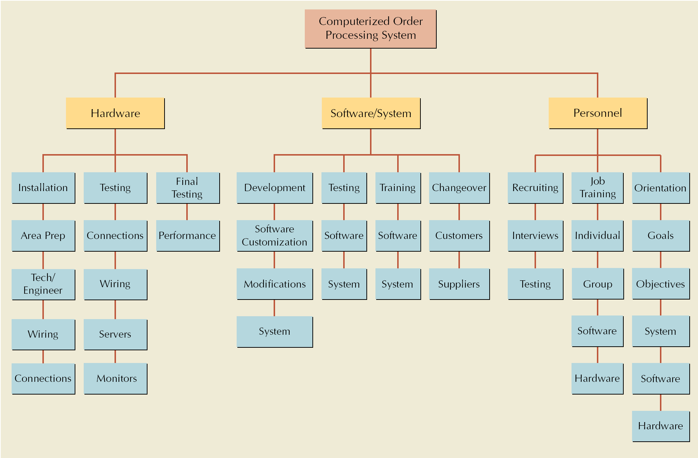
Work Breakdown Structure for Computer Order Processing System Project

Slide 31
Don’t forget
As you create the WBS, don’t try to solve the problems/risks that arise out of tasks
Have someone (more time “you”) note the risks and dependencies but don’t spend a lot of time solving the problems during WBS creation.

Slide 32
WBS – Information It Does Not Have
Durations
No reflection of how long things will take
Dependencies
No causal relationships between tasks
Milestones
Other than deliverables
So we will use Gantt Chart

Slide 33
Step 1: Create a Work Breakdown Structure
Before creating work breakdown structures, you should understand the two primary chart types: Gantt charts and PERT/CPM charts.

Slide 34
Step 1: Create a Work Breakdown Structure
What is a Gantt Chart?
Task group
Can present an overview of the project’s status, but does not provide detailed information that is necessary when managing a complex project

Slide 35
Gantt Chart
A GANTT chart is a type of bar chart that illustrates a project schedule.
GANTT charts have become a common technique for representing the phases and activities of a project work breakdown structure.
It was introduced by Henry Gantt around 1910 – 1915.

Slide 36
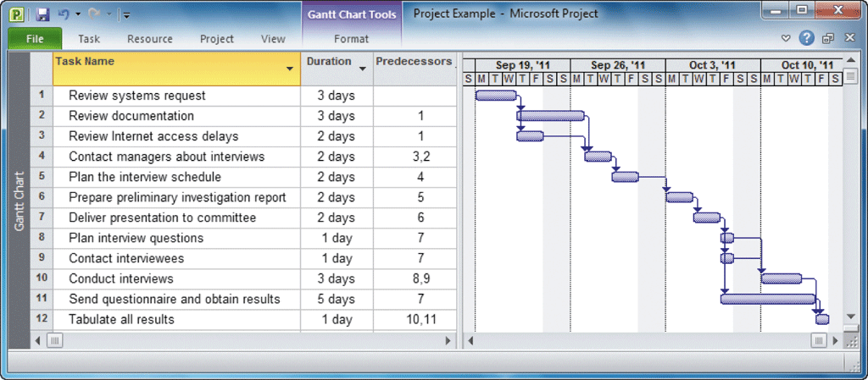
Gantt Chart

Slide 37
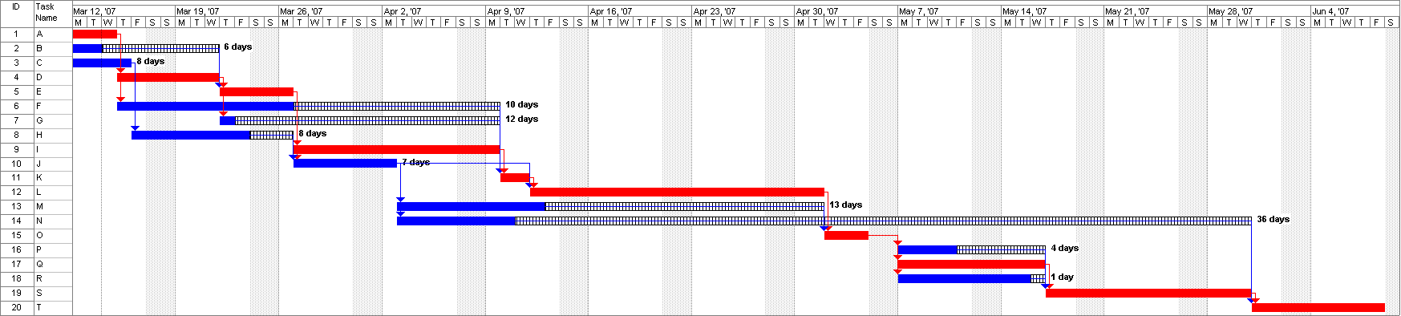
Gantt Chart

Slide 38
Gantt Chart
Characteristics:
The bar in each row identifies the corresponding task
The horizontal position of the bar identifies start and end times of the task
Bar length represents the duration of the task
Task durations can be compared easily
Good for allocating resources and re-scheduling
Precedence relationships can be represented using arrows
Critical activities are usually highlighted
Slack times are represented using bars with doted lines
The bar of each activity begins at the activity earliest start time (ES)
The bar of each activity ends at the activity latest finish time (LF).

Slide 39
Gantt Chart
Advantages
Simple
Good visual communication to others
Task durations can be compared easily
Good for scheduling resources
Disadvantages
Dependencies are more difficult to visualise
Minor changes in data can cause major changes in the chart

Slide 40
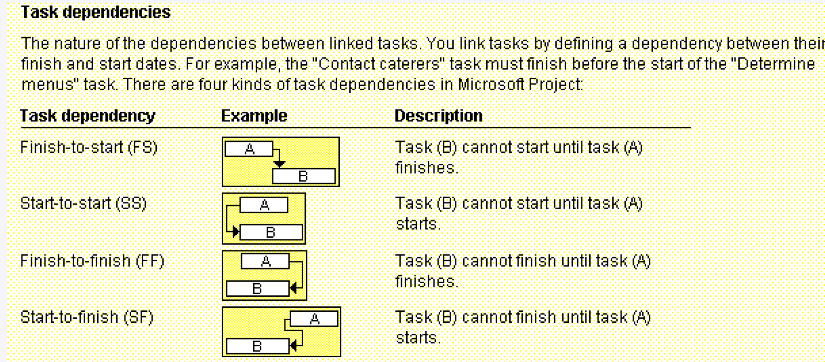
Precedence Diagramming Method (PDM) – a method of drawing network diagram
Precedence Diagramming Method (PDM) or Activity-on-Node (AON) – can have 4 types of dependences

Slide 41
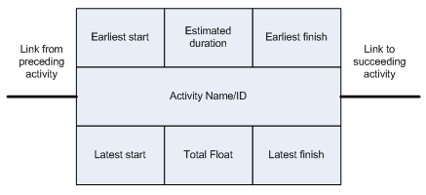
ES = Early Start
LS = Latest Start
EF = Early Finish
LF = Late Finish
EF = ES + D -1
LS = LF – D +1
Float (F) = LS – ES = LF – EF
Float - Is the amount of time that a task in a project network can be delayed without causing a delay.

Slide 42
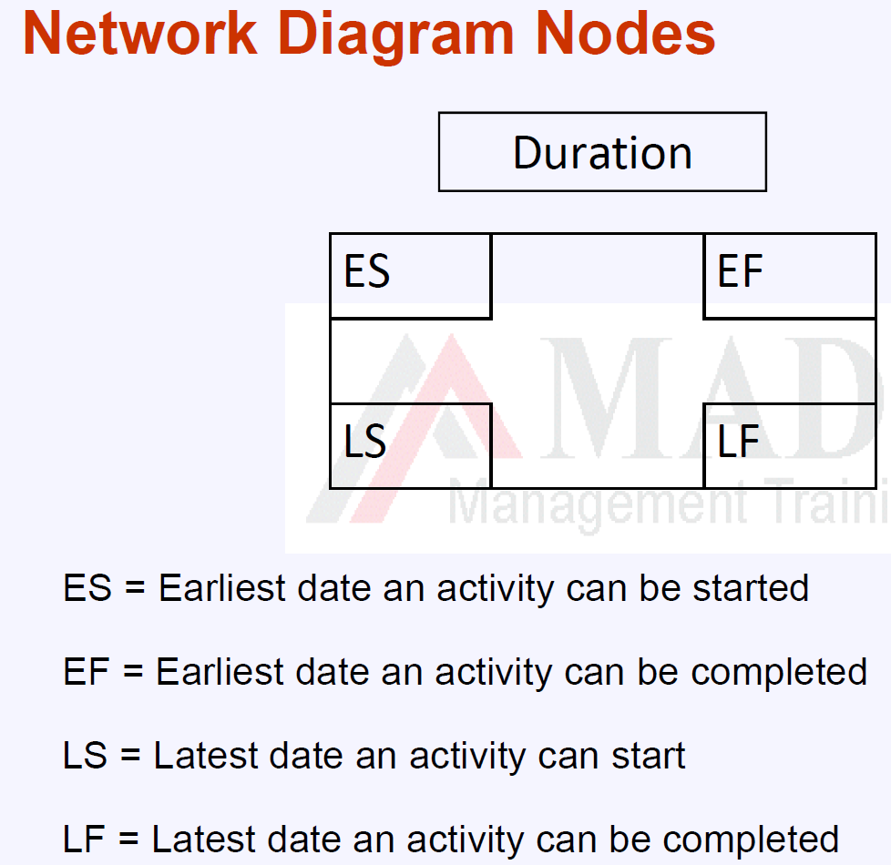

Slide 43
Step 1: Create a Work Breakdown Structure
What is a PERT/CPM Chart?
The Program Evaluation Review Technique (PERT)
Critical Path Method (CPM)

Slide 44
Define Activities - Decomposition
Decomposition in WBS subdivide total scope of project in to smaller components and decomposition in define activities subdivide work package in to smaller, more manageable components called activities.
WBS and WBS dictionary are the basis for development of activities.

Slide 45
3-Points Estimate (PERT)
Also called Program Evaluation and Review technique (PERT)
Use for time and cost estimation
Expected calculated from Most-likely, Optimistic, Pessimistic (A three-point estimate uses average of optimistic, most likely, and pessimistic estimates and hence improving the accuracy.)
Range of estimate = EAD (Expected Activity Duration) +/- SD (Standard Deviation/sapma,yayinma)
❖ Most likely estimate (M) – The realistic and most likely estimate
❖ Optimistic estimate (O) is the best case scenario.
❖ Pessimistic estimate (P) assumes the worst case scenario
Once you know the tasks, their duration, and the order in which they must be performed, you can calculate the time that it will take to complete the project
Expected (PERT Duration)
Standard
Deviation of Activity
Variance of an Activity

Slide 46
HW - for your project: Tree-point estimates (PERT)
Activity | Duration |  |  | Expected Duration (PERT) | Activity Standard Deviation | Variance range | Range of the estimate
 | P | M | O
A | 3 | 5 | 1 |  |  |  | PERT +/- SD
B | 8 | 4 | 2
C | 15 | 8 | 5
D | 20 | 10 | 5
Project (Total) | -

Slide 47
Step 1: Create a Work Breakdown Structure
Which Type of Chart is Better?
Although a Gantt chart offers a valuable snapshot view of the project, PERT charts are more useful for scheduling, monitoring, and controlling the actual work
PERT and Gantt charts are not mutually exclusive techniques, and project managers often use both methods

Slide 48
Step 1: Create a Work Breakdown Structure
Identifying Tasks in a Work Breakdown Structure
Break the project down into smaller tasks, creating a work breakdown structure

Slide 49
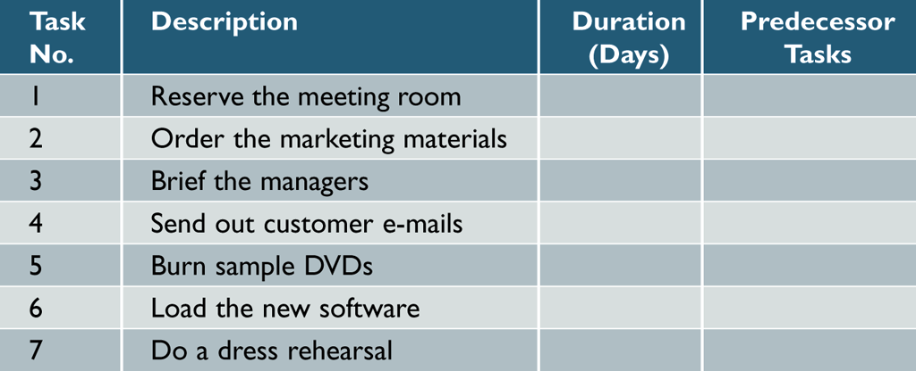
Step 1: Create a Work Breakdown Structure
Identifying Tasks in a Work Breakdown Structure
Listing the tasks
Can be challenging, because the tasks might be embedded in a document
Create a table with columns for task number, description, duration, and predecessor tasks

Slide 50
Step 1: Create a Work Breakdown Structure
Identifying Tasks in a Work Breakdown Structure
Estimating Task Duration
Person-days
Best-case estimate (B)
Probable-case estimate (P)

Slide 51
Step 1: Create a Work Breakdown Structure
Identifying Tasks in a Work Breakdown Structure
Estimating Task Duration
Worst-case estimate (W)
Weight
(B+4P+W)
6

Slide 52
Step 1: Create a Work Breakdown Structure
Identifying Tasks in a Work Breakdown Structure
Factors Affecting Duration
Project size and scope
Human resources
Experience with similar project
constraints

Slide 53
Step 1: Create a Work Breakdown Structure
Displaying the Work Breakdown Structure
If you are managing a complex project with many tasks, you can use task groups, just as you would in a Gantt chart, to simplify the list

Slide 54
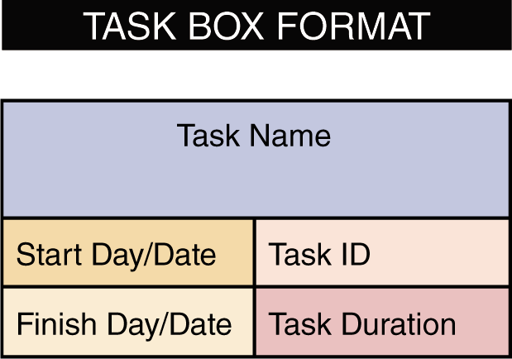
Step 2: Identify Task Patterns
How do I Use Task Boxes to Create a Model?

Slide 55
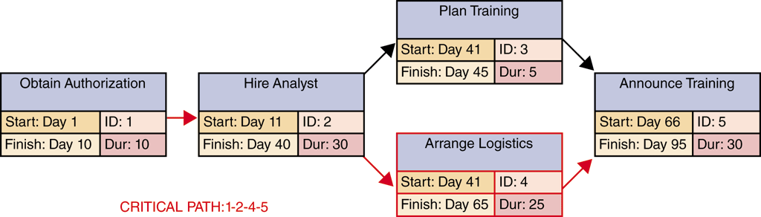
Step 3: Calculate the Critical Path
What Is a Critical Path?
The critical path method calculates the early start and finish dates, and late start and finish dates for all schedule activities
Critical Path is the longest duration path
Identify the shortest time needed to complete a project

Slide 56
Step 3: Calculate the Critical Path
How Do I Calculate the Critical Path?
First, you should review the task patterns
The next step is to determine start and finish dates, which will determine the critical path for the project

Slide 57
Project Monitoring and Control
Monitoring and Control Techniques
The project manager must keep track of tasks and progress of team members, compare actual progress with the project plan, verify the completion of project milestones, and set standards and ensure that they are followed

Slide 58
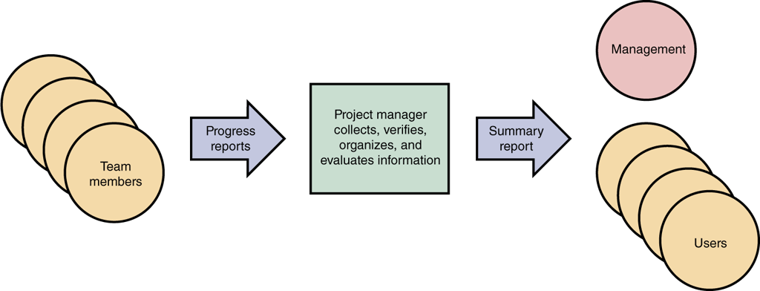
Reporting
Members of the project team regularly report their progress
Project Status Meetings

Slide 59
Reporting
Project Status Reports
A project manager must report regularly to his or her immediate supervisor, upper management, and users
Should explain what you are doing to handle and monitor the problem
Most managers recognize that problems do occur on most projects; it is better to alert management sooner rather than later

Slide 60
HW - till next lecture (online lecture) day
1. Prepare list of tasks and subtasks/ feature lists for your project
2. Create WBS of your project
3. Create PERT & CPM chart of your project
Prepare and bring to the next lecture day (practice day). We will discuss through your HW.

